Slide 1
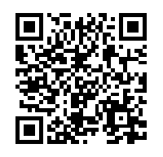
w
Did you know that you can ask your health visitor about sexual health? and ways to improve
your health to be fit for, during and after pregnancy?
Scan the QR code to read the leaflet and find lots of helpful information and resources.
Remember to ask your health visitor for more help and advice if you
need it.
If you don’t have a smart phone/ tablet, visit: https://ihv.org. uk/parent-leaflet- for-sexual-and- reproductive- health/
Published April 2021

